Slide 1
Molecular Biology Biol 480
Lecture 4 January 16, 2019

Slide 2
Announcements/Assignments
Comments on ”Decoding Watson”?
Pay attention to the history of DNA structure discovery---
New articles to read

Slide 3
Where were we…
Prions. Insoluble particles composed of a protein called PrP. The protein of prions folds very differently compared to the normal form of this protein, despite being encoded by the the same gene.
The mis-folded PrP proteins stick together forming prions which damage nerve cells.
Misfolded PrP proteins induce the mis-folding of normal proteins. They cause a type of protein replication without DNA

Slide 4
Where were we…?
Describe/sketch DNA as a chemical—what are its components and characteristics?
Describe/sketch DNA as a strand—how are nucleotides linked together?
Describe/sketch DNA as a double helix

Slide 5
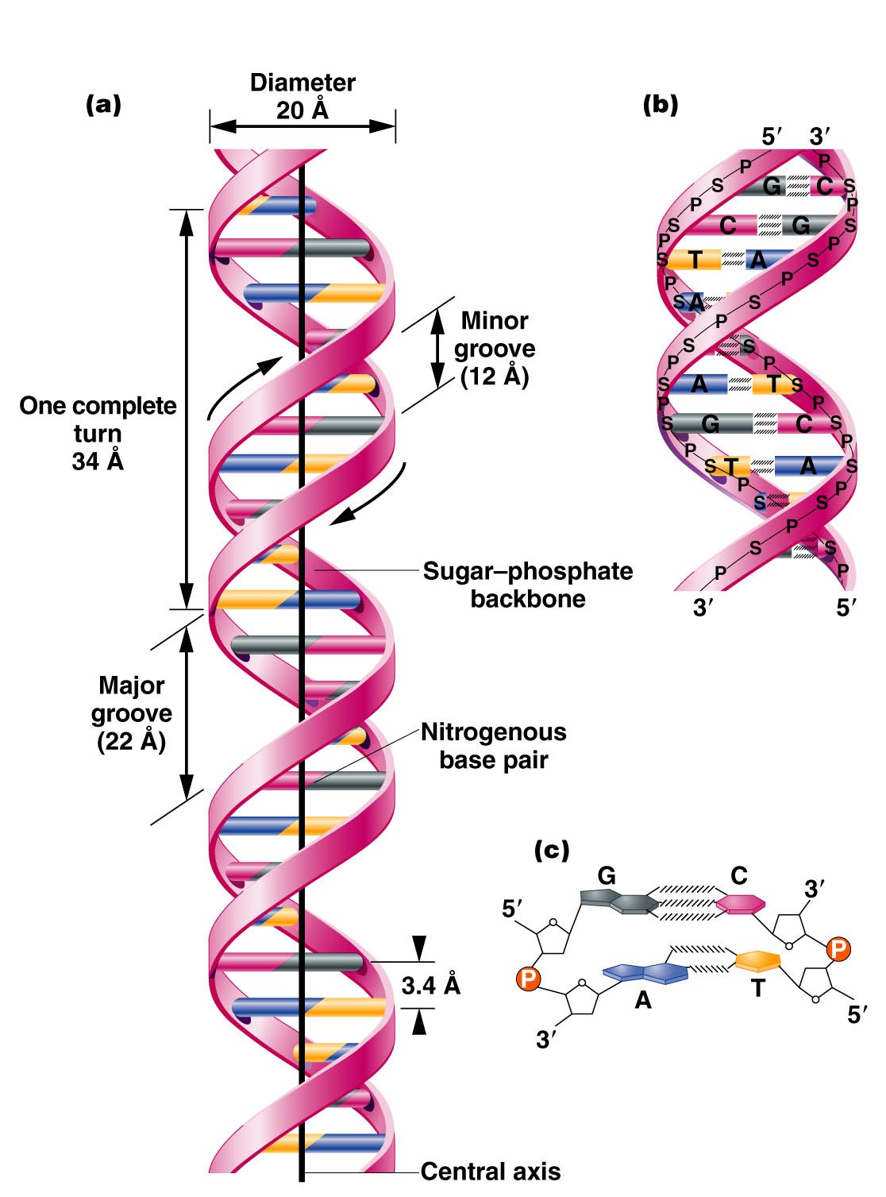
The Watson-Crick Model
B-form DNA
A=angstrom=
0.1nm
3.4 nm
.34 nm
Figure 10.14
Notes:
Figure 10-14 (a) The DNA double helix as proposed by Watson and Crick. The ribbonlike strands constitute the sugar-phosphate backbones, and the horizontal rungs constitute the nitrogenous base pairs, of which there are 10 per complete turn. The major and minor grooves are apparent. The solid vertical bar represents the central axis. (b) A detailed view depicting the bases, sugars, phosphates, and hydrogen bonds of the helix. (c) A demonstration of the antiparallel nature of the helix and the horizontal stacking of the bases.

Slide 6
B-DNA (also called Watson-Crick form) is the most common form of DNA in cells, but not the only structure that has been described using X-ray crystallography.
Helical direction, # of bases in a turn of helix, helix diameter, shape of backbone can vary

Slide 7
DNA can change shape due to dehydration, presence of ions, and specific base sequences.
For example, Z-DNA forms readily when DNA contains G-C-G-C-G-C…. In order for base pairing to occur, the sugar-phosphate backbone makes sharp turns (zig-zag) pattern in a left turning helix.

Slide 8
A-DNA forms when DNA is not surrounded by water. It is a right handed helix, but wider, due to the increased number of bases in each turn of helix.
Both A and Z-DNA are thought to exist in cells, under certain conditions or in certain regions of a chromosome, and may even affect gene expression

Slide 9
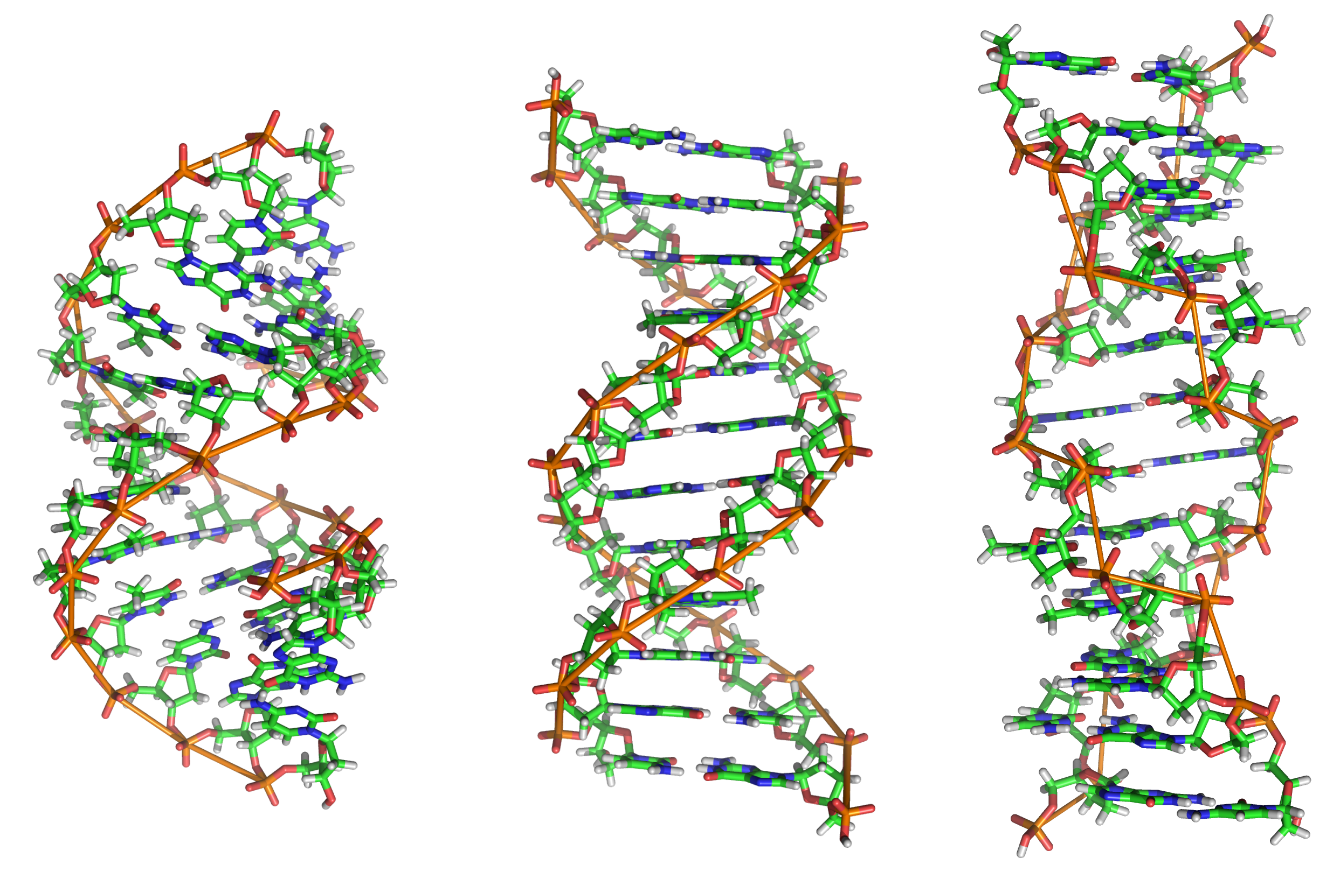
B-DNA
z-DNA
A-DNA

Slide 10
Let’s think about base-pairs in DNA. The structure is entirely the result of the stability of the interaction between A and T and between G and C.
The bond itself, is not covalent, but non-covalent hydrogen bond.

Slide 11
H-bonds
Weak electrostatic interactions between a covalently bonded hydrogen atom and a highly electronegative atom such as nitrogen or oxygen.
The hydrogen is slightly + charged and the O and N slightly negatively charged due to their unequal pull on electrons in their covalent bonds.

Slide 12
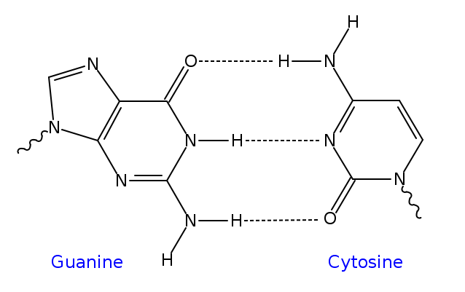

Slide 13
Only the pairings of A and T and G and C set up bond lengths and alignment to produce a stable molecule—the helix described by W and C.

Slide 14
Individually H-bonds are weak, but in polymers their collective strength is great.
Question. How many H-bonds are in a DNA molecule with 10 nucleotides, and the sequence of one strand 5’ ATTCGGCTAA 3’?

Slide 15
H-bonds are not only important in DNA.
Water! The life-giving properties of water are the result of the extensive formation of H-bonds.
H-bonds are important in other macromolecules, especially in forming protein structure.

Slide 16
Characteristics of DNA
A basic characteristic of DNA was revealed by spectrophotgraphy. It was shown early on in the search for the genetic material that nucleic acids absorb light in the UV range.
The bases of DNA and RNA absorb light at wavelength 260 nm. You can detect and quantify DNA and RNA solutions by their optical density using 260 nm.

Slide 17
In a future lab you will quantify and analyze the purity of DNA you isolate using UV spectrophotgraphy.

Slide 18
How do we study DNA?
Many of the techniques used to study DNA involve analysis of specific DNA sequence and on its complementary strand nature.
For example, DNA can vary quite a bit in the amount of repetitive sequence interspersed between protein coding genes.

Slide 19
Range of repetitive DNA sequence
Single copy---a sequence that appears one time in all the DNA of the organism. Many genes are single copy.
Middle repetitive—10-10,000 copies
Highly repetitive-- > 10⁶ copies

Slide 20
Repetitive DNA can be found in multiple positions on many or all chromosomes of an organism. Called interspersed repetitive DNA.
There are relatively short repeats known as Short Interspersed Elements or SINEs and relatively long sequences called Long Interspersed Elements known as LINEs.

Slide 21
We will talk more of these features of DNA in chapter 12. (next)

Slide 22
In my genetics class we do a lab in which we analyze a specific spot in our own genome (on chromosome 16) for the presence of absence of a SINE called an Alu repeat.
Some people have an Alu repeat in this region, whereas some people don’t. And some of us have the repeat on one chromosome 16 and not on the other. Because of the variability in this region, it is know as a gentic polymorphism.

Slide 23
Repetitive DNA can also be found in the genome in multiple copies repeated over and over in the same region.
These are known as tandem repeats
Tandem repeats can vary in length from 2-4 nucleotides (called microsatellite repeats)
Longer tandem repeats (10-60 nucleotides) are called minisatellite repeats.

Slide 24
Spectrophotometry can be used to analyze the amount and type of repetitive DNA in an organism.
The analysis takes advantage of the complementary base-pairing of the DNA strands.

Slide 25
As you know, DNA strands are held together by multiple H-bonds between specific bases on opposite strands.
The bonds can be broken by various means including high heat and high pH. The process of disrupting the base-pairing of 2 DNA strands is called denaturing.

Slide 26
Likewise, DNA that is carefully, purposely denatured can be renatured or reanneal---if conditions are reversed, the DNA can reform its H-bonds and complementary base-pairs can form.
YouTube: https://www.youtube.com/watch?v=-k7WovEbXfQ

Slide 27
As DNA denatures, its absorption of light (optical density—OD) at 260 nm increases. A sample of DNA which is heated to near 100 degrees C will show an increase in absorption until all the DNA is single stranded.

Slide 28
Also…see Figure 10.16
Sigmoidal curve showing denaturing of DNA
The melting temperature (Tm) is the temp for a given sample of DNA in which half is SS and half is DS.

Slide 29
Likewise…
If you cool the DNA slowly you can allow the bases to reform and the DNA renatures or reassociates into double strands.
As renaturation occurs, the OD decreases until all the DNA is double stranded.

Slide 31
Renaturation/reassociation kinetics tells you something about the DNA sequence.
What might slow or speed the reassociation of DNA strands?
(figure 10-16)

Slide 32
Using reassociation kinetics to analyze repetitive sequence in DNA
DNA from different organisms can be analyzed using DNA denaturing and reassociation kinetics.
1. Isolate all the DNA from cells of an organism
2. Denature/melt DNA with heat
Cool DNA to allow reassocation of DNA strands
At the same time, measure OD₂₆₀ over time.

Slide 33
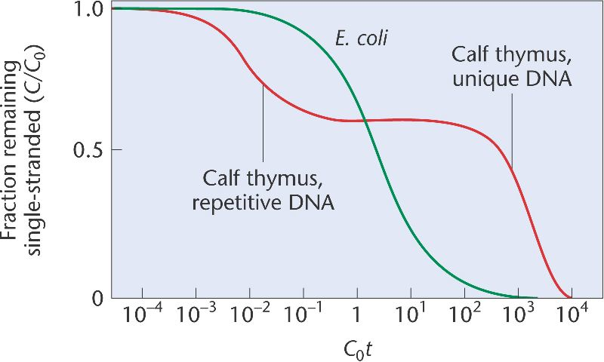
OD₂₆₀
Time

Slide 34
Think of the curve as a comparison of prokaryotic and eukaryotic DNA
Make some conclusions from this experiment.
Start with basic observations, then look more deeply at the data.

Slide 35
The more repeats in the genome of an organism, the faster the renaturation. Why?
Renaturation occurs in phases or fractions.
Be able to interpret a reassocation curve.

